Slide 1
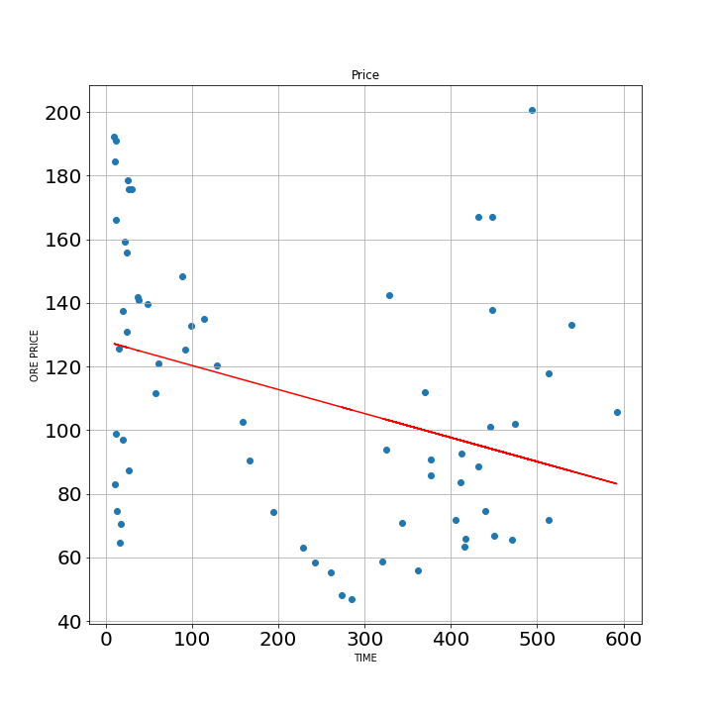
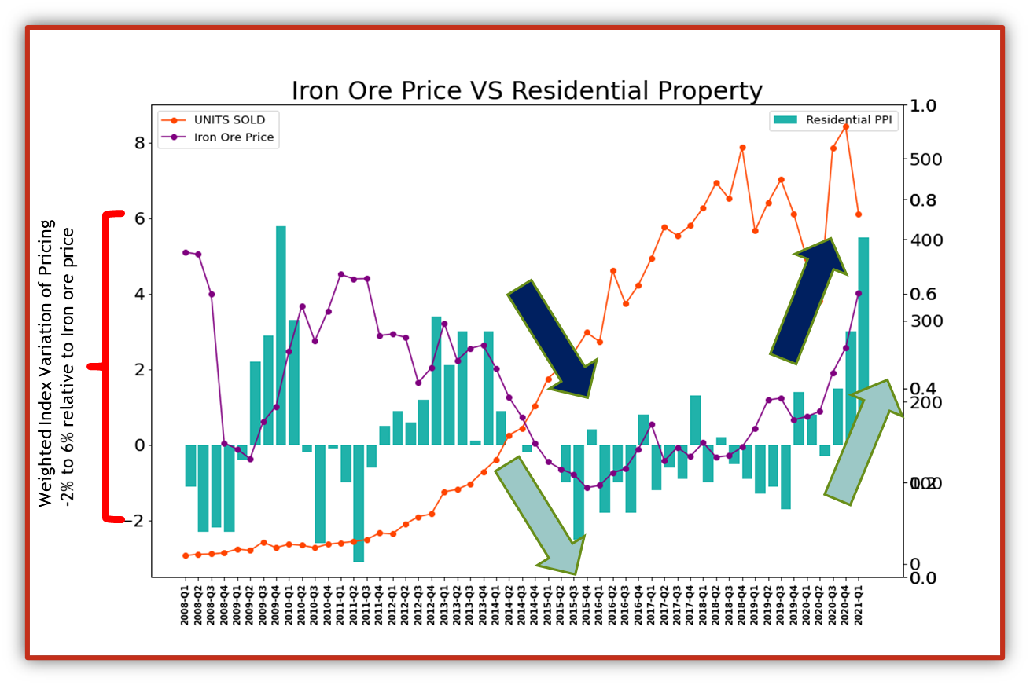
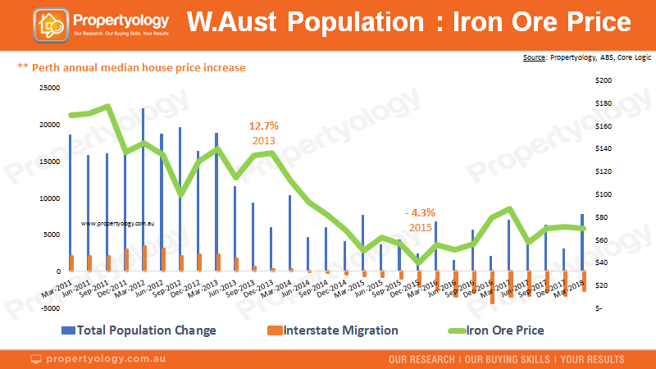
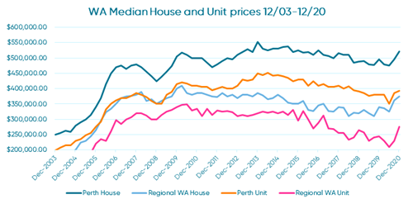




Iron Ore Price vs. Perth Housing Market
What did we ask ourselves?
If there a correlation between the iron ore price cycle and Perth’s residential property prices?
How do the iron price rise and fall impact the Perth residential property price weighted average index?
How does the quarterly price vary over the research time period?
How does the relation ship between iron ore price rise and fall affect the future of the Perth property market
Khansa Rubab Malik
Johan Snyman
Joseph Koroma
Create a single point of view to tell the story through the data analysis
Load and Read house Data File
Reduce and rename to Required columns (By deleting duplicate
Verify counts, check unique values and create PERTH specific DF
Load, Clean and Merge Iron data with housing data
Design and Print Graphs to explore relationship
Develop and deploy an API to collect the housing data
What did we find?
There is no-correlation of iron_ore price and Number of Unit Sold w.r.t time value because,the R-squared value is -0.3, which means no data fit in the model.
The results show an apparent correlation between iron ore price (purple line) and housing price index (green bar), however it also shows and inverse for the number of units sold (orange)
The reviewed data points to an increase of first home owner grants increasing in 2008 with the commencement of a rates easing cycle by the RBA in 2011 that coincide with a slowdown in housing stock in 2012.
Anectdotaly…The correlation is not exact as the average household debt starts increasing in 2014 and the trend is still growing, this may be related to the increase in housing stock turnover regardless of the iron ore price
R-squared= -0.2
What is our conclusion….. Source: Propertyology, ABS, REIWA
Property logis says… “there is no direct relation, but prices on the global commodity markets will certainly have some effect on both our economy, and our property market.”
REIWA concludes…”Probably with a lag effect. It will take a few quarters of upturn on the one (commodities) to filter through to the property market, and it will also work slowly on the way down”
Time will tell.
https://www.bmtqs.com.au/bmt-insider/population-records-broken-all-over-australia/

